Slide 1
Real world analysis 4
Effect size, discrepancy measures and assorted tests.

Slide 2
Today
Effect size
Standardized
Natural
Clinical
Simple exercises online
Code review
Individual support

Slide 3
For the reader to appreciate the magnitude or importance of a study’s findings, it is almost always necessary to include some measure of effect size in the Results section” (APA, 2016, p. 3).

Slide 4
Standardised effect size measures
We want a way of comparing how large an effect is between studies.
Different measures
Different interventions, settings etc…
Comparison between studies in meta analysis
Three types:
- relationships
- differences
- variance explained

Slide 5
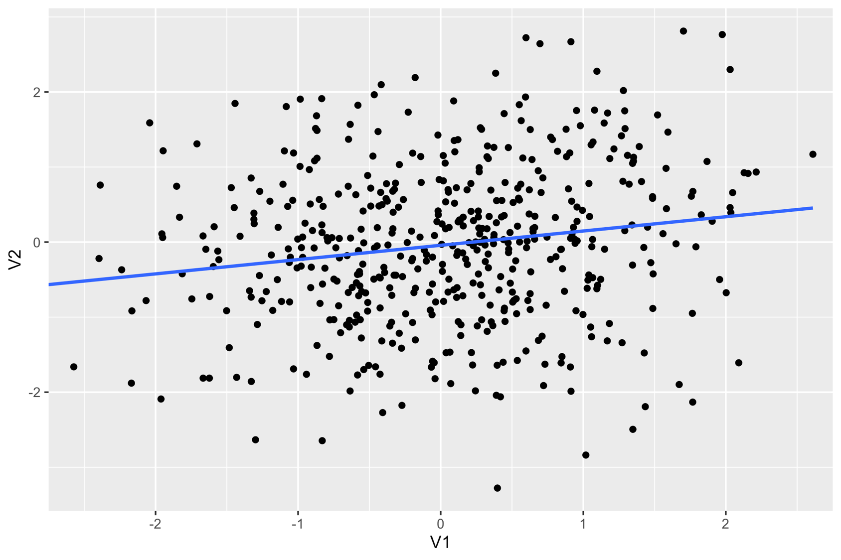
Notes:
What would we use as a measure of effect size of relationship strength if we had data likes this?

Slide 6
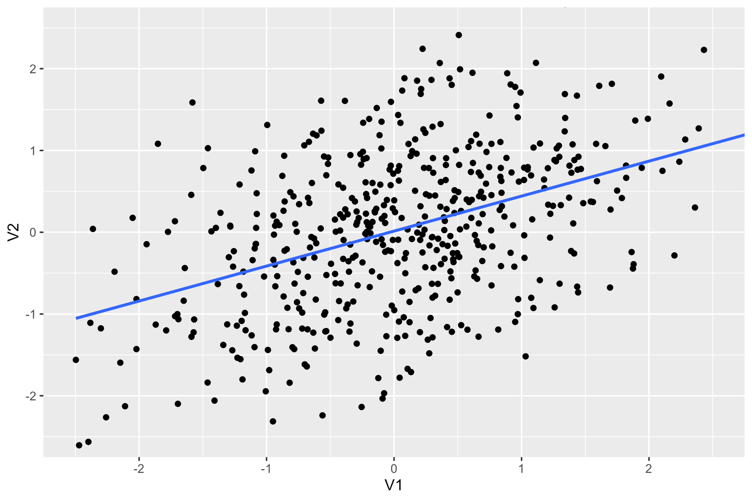
Notes:
As the relationship gets stronger the line gets steeper, which is how we can describe the relationship with a (single number for the slope)
The number is typically the Pearson correlation coefficient, R
Although nonpara alternatives

Slide 7
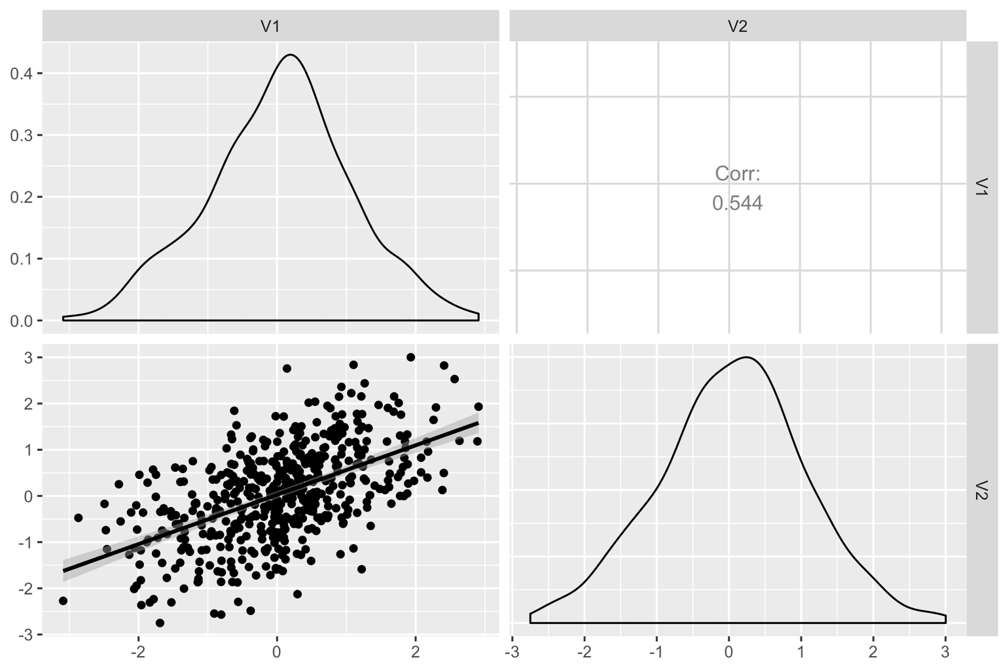
Notes:
What makes it standardised is that it doesn’t matter what the average of each variable is, or the units we use…
This is the same data plotted using the ggpairs function.
One thing to imagine… think of the right hand density turned on it’s side…. That’s how it really should be.
This way, you can see how the correlation describes the variance explained…. If it were a flatline then the points scatter around the line and would be described by the variance alone

Slide 8
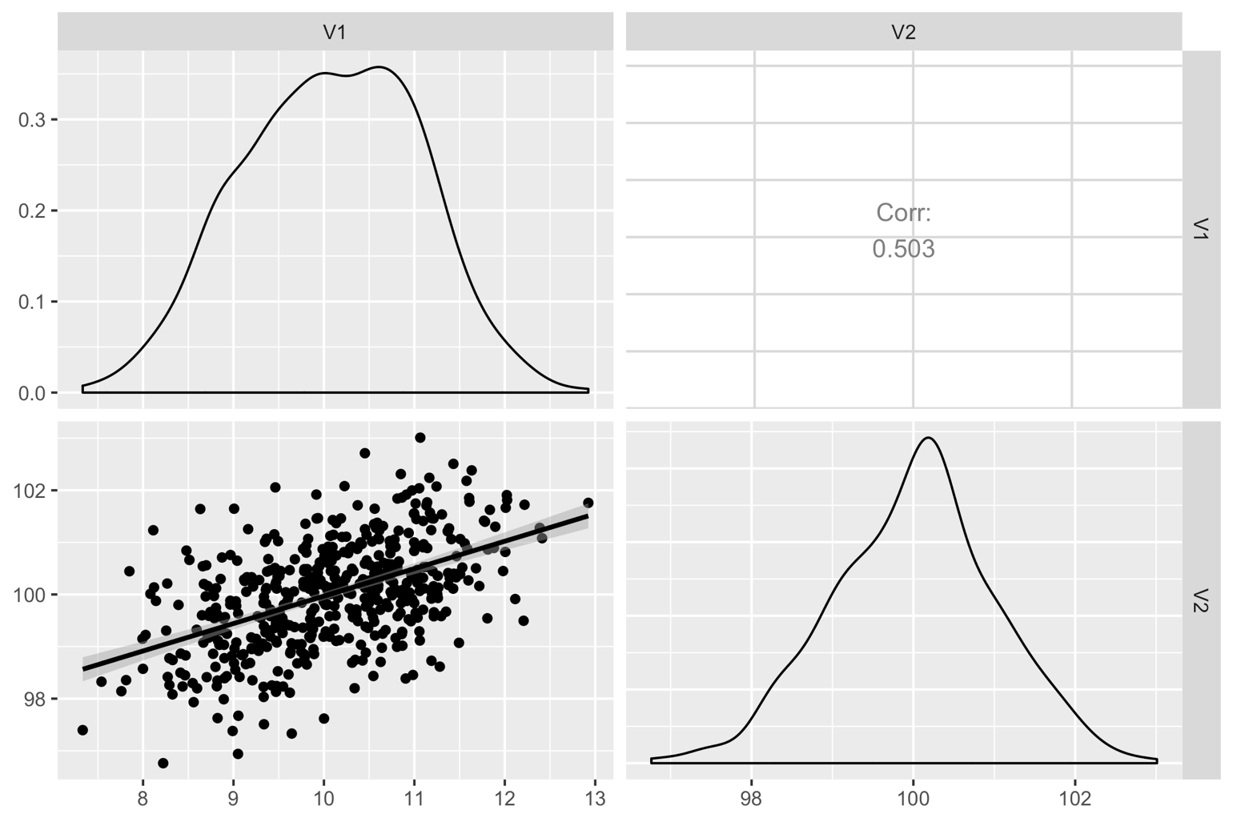
Notes:
This plot shows more simulated data with the same correlation, but different variables with different variances. The relationship is the same, even though the scale has changed

Slide 9
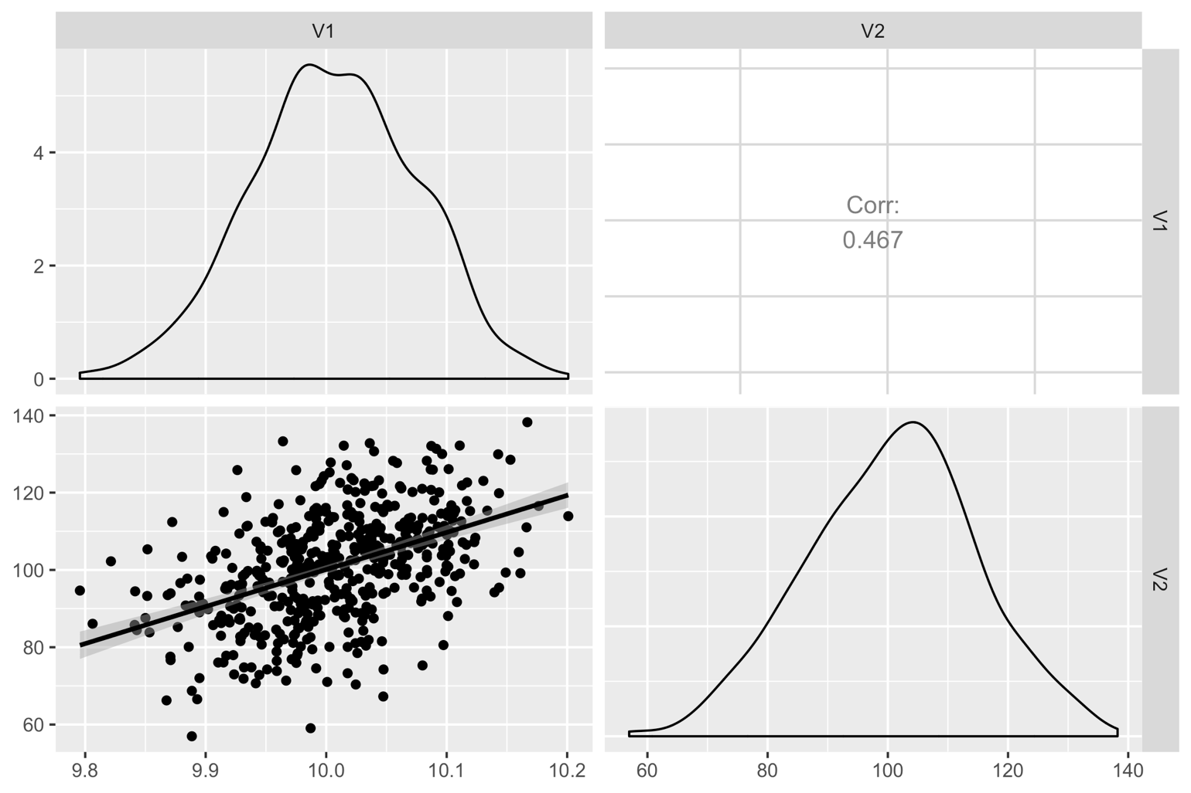
Notes:
This shows how another dataset with a relationship that ’s the same, but where the variances of each of the variables are very different
Here the xvariable has ver small var, y var has very large

Slide 10
Correlation
Measure of relationship strength or effect size
Insensitive to (unaffected by):
Means
Variances
Notes:
The point here is to show how pearson rho is a measure of relationships strength or effect size that is somewhat invariant to the type of measurements you use

Slide 11
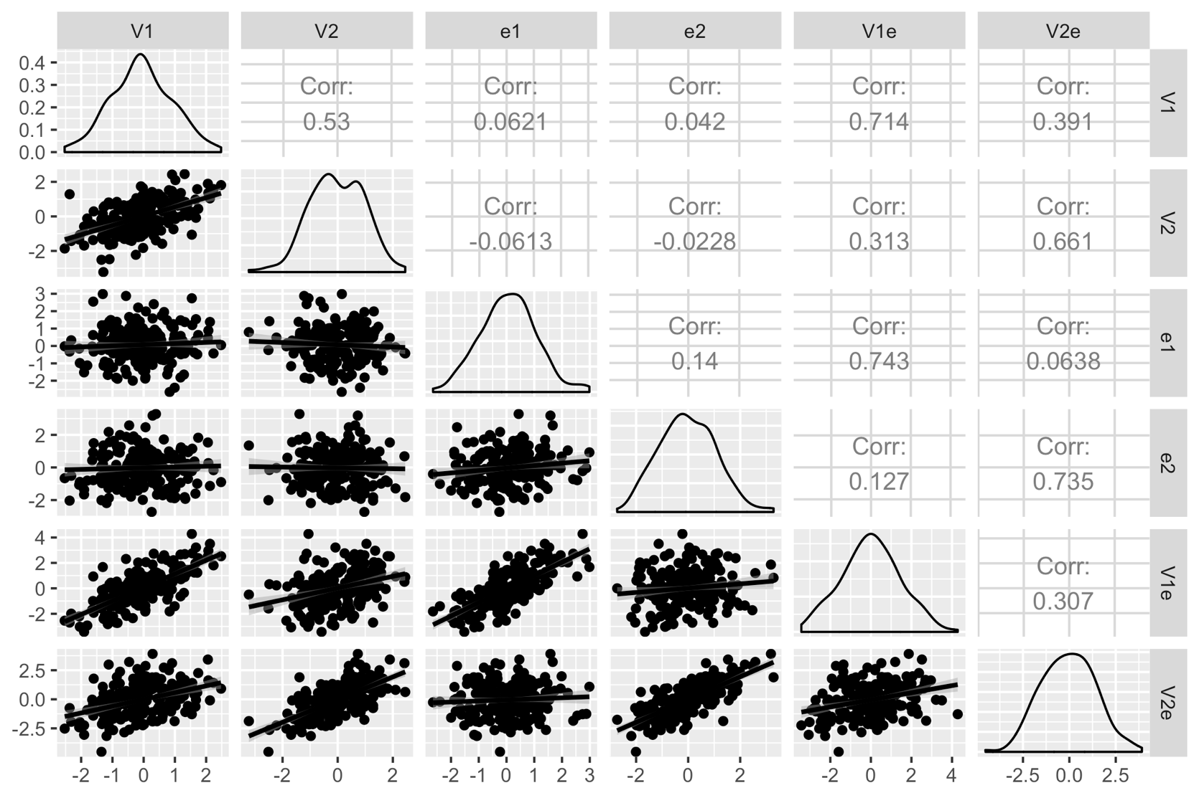



Notes:
One thing to be mindful of though is that correlations are quite sensitive to measurements errors, which means you need to be careful when comparing correlations across studies. This is quite a complicated plot, but it shows:
Two variables v1 and 2
Two errors… these are random noise. Imagine it’s mistakes in data entry, or a wonky keyboard
If we add the errors to the measures V1 and 2 when we get V1e, V2e
If we correlate the measurements with error we get a lower value (see yellow correlations highlighted)

Slide 12
Notes:
We also have to make sure that the relationship is linear!

Slide 13
Limitations
Assume a linear relationship.
Assume NO measurement error
This is also true of regression predictors
outcome = predictor × coefficient + error
We only have an error on the right-hand side

Slide 14
Effect sizes for group differences
Notes:
simplest case is when you have two groups randomly assigned and then a post-measurment

Slide 15

Δ
SD A
SD B
Notes:
The interesting bits here are the difference + the SD for each group
We want to combine all these numbers into a single metric

Slide 16
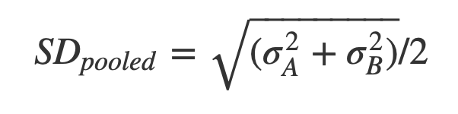
Cohen’s D
Difference
Divided by
POOled
Standard
deviation
DIDPOOS
Notes:
d is a standardised effect size measure because we are dividing by standard deviation
This makes it somewhat comparable between studies, variables etc.

Slide 17
Interpreting Cohen’s D
Rules of thumb
Important to place confidence interval around D
i.e. “D = .5, 95% CI = 0.1 to 0.9”
 | Cohen’s D | Pearson ρ (rho) | Variance explained
Small effect | 0.2 | .1 | 1%
Medium Effect | 0.5 | .3 | 6% / 9%
Large Effect | 0.8 | .5 | 16% / 25%
Notes:
Cohen’s conventional thresholds for D. Small effect: difference in height between 15 and 16 year old girls, on average. Medium: individual psychotherapy (medium to large). Large effect: hand washing
R to d conversions - this is what happens in meta analyses
Variance explained is another way of thinking about it, and makes D comparable with other effect size measures…. To some degree all are measuring variance explained, but counting it in different ways. Often the difference is how we count the denominator — that is, what is the total variance we hope to explain? This alters the proportion we think we have actually explained.

Slide 18
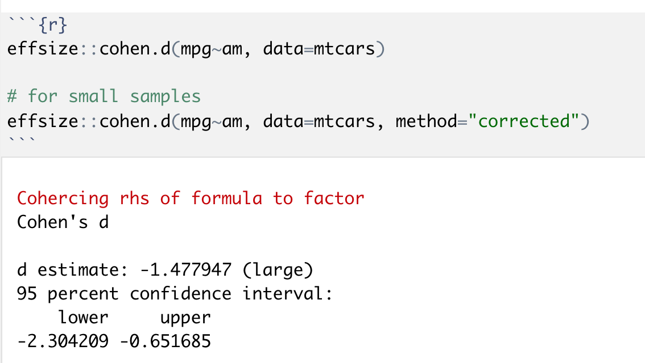
Cohen’s D in R
Notes:
Note we interpret the absolute value,… negative 1.4 is still large
Point out the corrected option, which is especially for samples < 50. This is because D is a sample statistic, not a population statistic.

Slide 19
Notes:
[plot showing D=.8 with different SDs]
Danger of D is that it depends heavily on the SD/variance of the measure itself. If you have a noisy measure then D will be reduced.
First panel is with small var
Second is with larger var
DIFFERENCE IS THE SAME
Substantive interpretation may be the same
How might we find data like this, where effect is the same but variance different?
One example might be Inclusive vs narrowly controlled trial populations. E.g. Star*D trial https://en.wikipedia.org/wiki/STAR*D
Some efficacy RCTs would only include <5% of real caseloads
Also point out here that even large effects are quite subtle when looking at a density plot... hard to eyeball sometimes

Slide 20
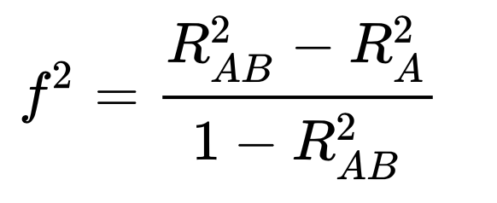
Effect size by variance explained
f²
Partial eta²
Nice discussion/comparison/explanation: https://www.theanalysisfactor.com/effect-size/
Reference for many different calculations/scenarios: https://www.psychometrica.de/effect_size.html
E.g. can calculate eta sq and cohen’s D from an Anova F statistic
Another good reference: http://imaging.mrc-cbu.cam.ac.uk/statswiki/FAQ/effectSize
effsize package has many different statistics
Notes:
F squared (and eta squared) work on the basis of the proportion of variance explained.
Can see the f2 gets larger as the difference between models A and AB gets bigger
This is a way of describing hierarchical regression which we saw earlier.

Slide 21
Effect sizes may be expressed in their original units (e.g. …kg/month…) and are often most easily interpreted when expressed in their original units” (APA, 2016, p. 3).
Notes:
Effect sizes in natural units are important too

Slide 22
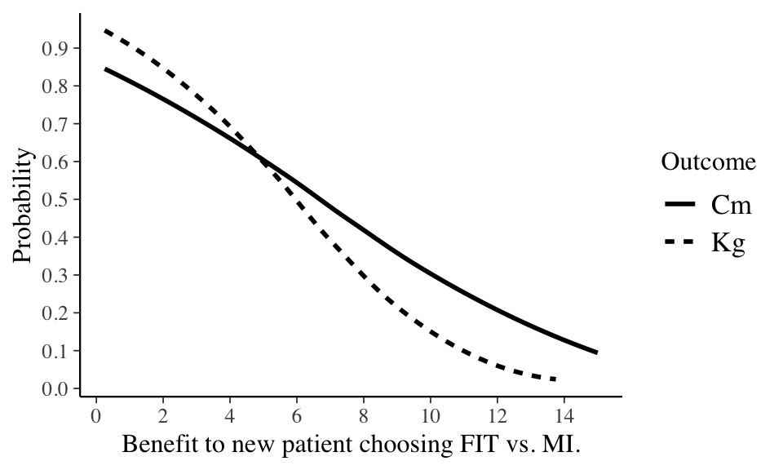
Notes:
Explain the plot which comes from Sobrig paper (ref onnext slide).
Also ask what extra plot feature we should add? (Horizontal/vertical lines… but not allowed by the journal)

Slide 23
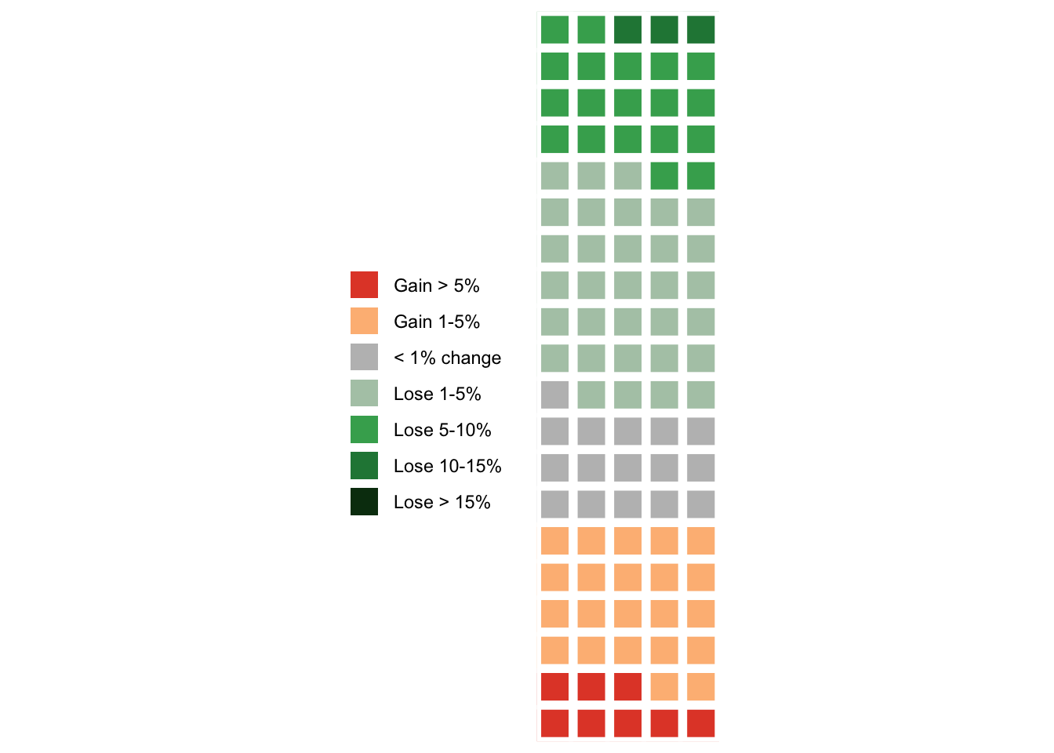
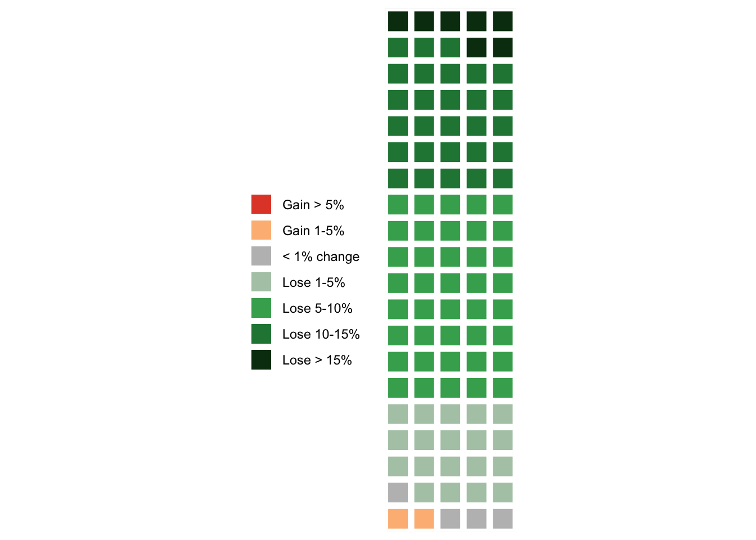
MI
FIT
Solbrig, L., Whalley, B., Kavanagh, D. J., May, J., Parkin, T., Jones, R., & Andrade, J. (2019). Functional imagery training versus motivational interviewing for weight loss: a randomised controlled trial of brief individual interventions for overweight and obesity. International Journal of Obesity, 43(4), 883-894.
Gigerenzer, G. (2011). What are natural frequencies?. Bmj, 343, d6386
Galesic, M., Gigerenzer, G., & Straubinger, N. (2009). Natural frequencies help older adults and people with low numeracy to evaluate medical screening tests. Medical Decision Making, 29(3), 368-371.
Chicago
Notes:
Natural frequencies. Colour scale chosen specifically to match up to clinically meaningful thresholds: all green squares are 5% of body weight which is considered a clinically meaningful milestone and would be important for this audience of physicians.
In depression 17.5% https://www.ncbi.nlm.nih.gov/pmc/articles/PMC4611356/
Or 2 points on HAMD if you are the FDA for drug approval
Always somewhat arbitrary, but could be linked to external outcomes (e.g. unemployment, suicide risk)
Mention other Gigerenzer work on natural frequencies. Especially important when numbers are very small or very large (one in 500 much more scary than 0.2 %… Perhaps one in 800 if we say 60% of population gets it). Important in behaviour change contexts.

Slide 24
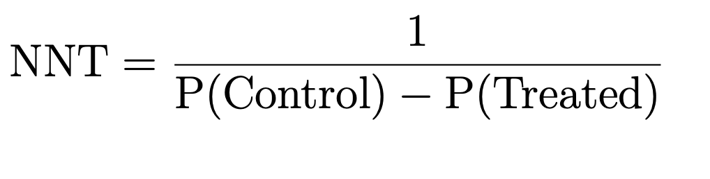
NNT: Number Needed to Treat
Notes:
Number needed to treat popular among doctors (see also NNHarm)
P(Control) is probability of good outcome in control grouop… and so on

Slide 25
Examples of NNTs
Antibiotics for bronchitis =
18
Asprin for stroke =
10,000
Statins for stroke =
268
Antidepressants for depression =
∼ 9
Psychotherapy for depression =
∼ 3
Notes:
At end of slide… ask, so how might we calculate NNTs for depression or behavior where outcome is continuous?
Defining treatment success with continuous outcomes (easier when people just die or recover)
One way might be to count number of patients who have hit arbitrary clin sig thresholds (like 5% body weight)
Another is reliable change index…

Slide 26
Defining treatment success
Clinically reliable change
Introduced in Jacobson, Follette, and Revenstorf (1984), but best summary is Jacobson and Truax (1991)
All measures involve uncertainty.
Reliable Change (RC) is about whether people changed sufficiently that the change is unlikely to be due to simple measurement unreliability.
Jacobson, Neil S, and Paula Truax. 1991. “Clinical Significance: A Statistical Approach to Defining Meaningful Change in Psychotherapy Research.” Journal of Consulting and Clinical Psychology 59 (1). American Psychological Association: 12.

Slide 27
Clinically reliable change
Measures have a reliability
Internal
Test-retest
Reliability limits how certain we can be
Want to say someone changed more than might be expected by chance
Is this ‘real’ change > 95% of the time?

Slide 28
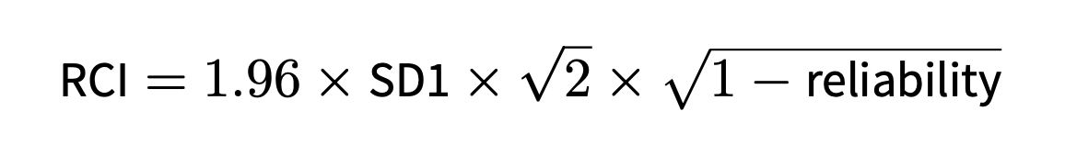
RCI: Reliable Change Index
Notes:
This is the formula. Important points are the SD1 = SD at baseline
Reliability is the scale reliability, ideally test-retest reliability

Slide 29
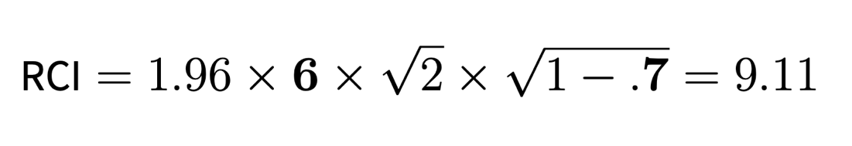


RCI: Reliable Change Index Worked example for Hamilton Depression Scale
SD of HRSD at baseline
Test-retest reliability (correlation) of HRSD
Notes:
This is a worked example… HRSD has SD of about 6, and reliability of about .7 to .8 depending on timescale
So, to be sure change is clinically reliable would want to see improvement of 9 points
Count number of people who improve by this much == success
Remember that there may be floor effects so harder to compare across mild/severe populations

Slide 30
Summary of today
Effect size measures are important
Contextualise results
Avoid “star-blindness”, especially in non-applied work
Plotting effect sizes is especially powerful
Standardised measures can be useful
Comparison between studies/domains (can convert between units)
But sensitive to variation
Natural units can be clearer
Especially in applied work, report both
Think about range of prognosis for patients, not p values
Reliable/clinically meaningful change + NNT also useful

Slide 31
Assessment
“Replicate the statistical analysis using methods which are appropriate to the data.”
“Compare/contrast your results with the published manuscript as appropriate. ”
“Discuss the extent to which the concept of ‘researcher degrees of freedom’ (Simmons et al 2011; Gelman and Loken 2013) should influence our understanding of your chosen study.”
“You do not need to use the exact method used in the original paper in all cases; the point of the exercise is to apply methods we have learned in an appropriate way. For example, you may wish to apply Bayesian techniques to a dataset previously analysed with frequentist methods; this would provide additional opportunity to demonstrate understanding of the material and appropriate application of techniques.”
Notes:
Assessment: wanted to pick out some key points because of questions in the feedback. Issue of how we will assess when papers replicated are so diverse…
What is expected
What working at SEEC level 7 means

Slide 32
What is expected
Replicate the paper exactly, as best you can.
Apply techniques from the course appropriately to make sense of the data as best you can.
Sometimes this will mean reporting additional analyses, or sensitivity analyses. This will help with the question on researcher degrees of freedom.

Slide 33

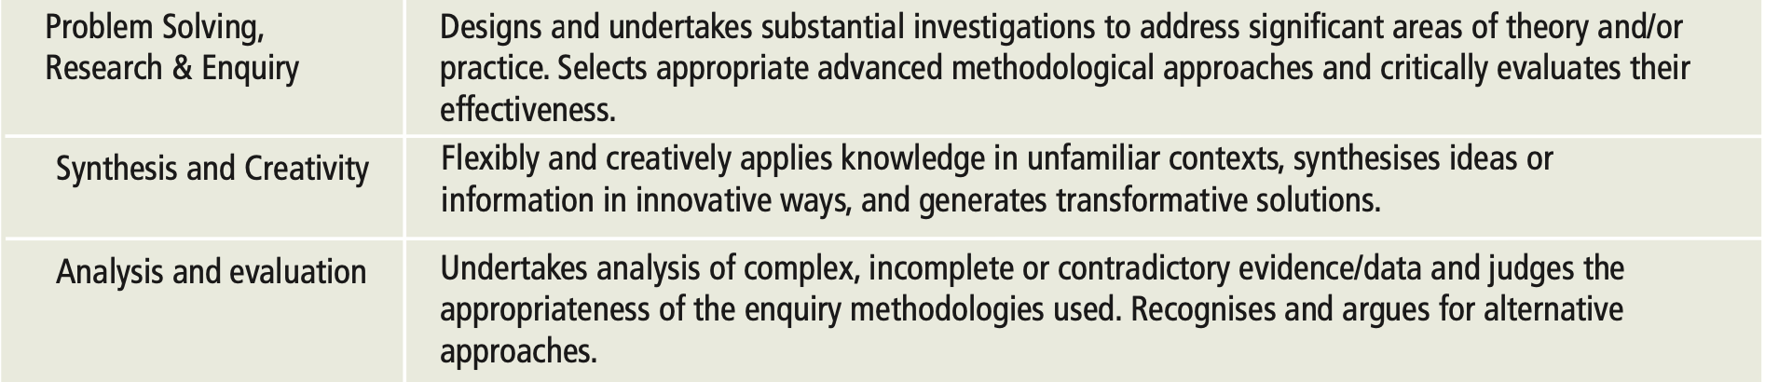
SEEC Level 7 Attributes
http://www.seec.org.uk/wp-content/uploads/2016/08/SEEC-descriptors-Dec10.pdf

Slide 34
Housekeeping
Final session on 21st April (same Zoom link)
Assessment dates on DLE
Office hours at 1pm Tu, Th.
Let me know in advance if possible
Zoom link for office hours: https://plymouth.zoom.us/j/9101503592
Next:
https://benwhalley.github.io/datafluency/session-4-effect-sizes-and-discrepancies.html
Code review
Notes:
Remember also… additional stats like Levene’s in notes online

